Slide 1
Gender and Social Movements
Agenda:
Chafetz, J. S. (Ed.). (2006). Handbook of the Sociology of Gender. Springer Science & Business Media.
8- Gender Movements (Group 1.2)
Risman, B. J., Froyum, C., & Scarborough, W. J. (Eds.). (2018). Handbook of the Sociology of Gender (pp. 19-43). Cham: Springer International Publishing.
39- Gender in Movements (Group 4.5)
40- Feminists Reshaping Gender (Group 3.6.7)
In the U.S. : Black Lives Matter, #SayHerName #MeToo
In the Middle East: Woman Life Freedom Mourning Mothers Movement
Question:
Question: What brings a specific group of women to organize a movement?

Slide 2
THREE OF THE MOST IMPACTFUL MOVEMENTS OF THE LAST DECADE
were created by black women using feminist strategies and interventions:
Black Lives Matter,
#SayHerName
#MeToo

Slide 3
Black Lives Matter (BLM)
BLM was founded by Alicia Garza, Patrisse Khan-Cullors and Opal Tometi in 2013 after the acquittal of George Zimmerman in the death of Trayvon Martin. BLM is a decentralized political and social movement that seeks to highlight racism, discrimination, and racial inequality experienced by black people and to promote anti-racism.
The movement gained international attention during global protests in 2020 following the murder of George Floyd by a white police officer. An estimated 15 to 26 million people participated in Black Lives Matter protests in the United States, making it one of the largest protest movements in the country's history.

Slide 4
#SayHerName #BlackGirlsMatter
The #SayHerName campaign was founded by scholars Kimberlé Williams Crenshaw and Andrea J. Ritchie and the African American Policy Forum (2014) as a way of bringing attention to black female victims of sexism, racism and police brutality.
It was a response to the marginalization of Black women within both mainstream media and the #BlackLivesMatter movement to highlight the issues of women who have died due to police brutality and anti-Black violence in the U.S.

Slide 5
#MeToo
The movement went viral in 2017 after actor Alyssa Milano, a white influencer, began using the hashtag in solidarity with the sexual-assault victims of Hollywood producer Harvey Weinstein. However, #MeToo was first used by activist Tarana Burke in 2006 as a way of empathizing with survivors of sexual harassment and assault. Milano used her platform as a celebrity to amplify Burke’s voice, ensuring that she would be recognized for her pioneering work.

Slide 6
#MeToo is a social movement against sexual abuse, sexual harassment, and rape culture in which people publicize their experiences of sexual abuse or sexual harassment.
The MeToo has encouraged many women to come forward. It was entirely possible that due to fear of formal or informal retaliation, some victims quit the job instead of filing a complaint.
MeToo provided the victims with a platform to express their personal experiences, to get social support, and ventilate their feelings. Many personal stories of anger and guilt, buried under years of silence, emerged out to public media.
MeToo provides heightened awareness and promotes a quasi-legal framework around social and workplace harassment. It would provide a safer and more sanitized work environment.
Benefits from MeToo Movement

Slide 7
Me Too led to “trial by media” with alleged persons publically “blamed and shamed” before getting a chance to defend themselves and having an opportunity of a fair trial.
Unethical use of these platforms can lead to broken faith in the relationship.
The fears of wrong accusations, gender segregation, and adverse impact on women’s careers. For example, some individuals may have the desire to keep distance from females. 56 The Bloomberg’s article “Wall Street rule for the MeToo era: “avoid women at all costs”.
sometimes, offenders can try to threaten the victim that may have bad impact on the victim (Retaliation).
Bad aspects of MeToo phenomenon

Slide 8
Over reporting and false allegations are the ugly faces of these movements. Due to prejudice against victims, many professionals considered that nearly 50% of claims were false. Some wrongful allegations may lead to severe damaging consequences on the reputation and careers of people who were accused falsely even if they were ultimately proven innocent.
The experience of sexual harassment is essentially subjective and dependent on the cultural and socioeconomic context of the societies in which it occurs, and it appears that different types of sexual harassment have different meanings in different cultures (McCann, 2005)
The ugly aspect of MeToo phenomenon

Slide 9
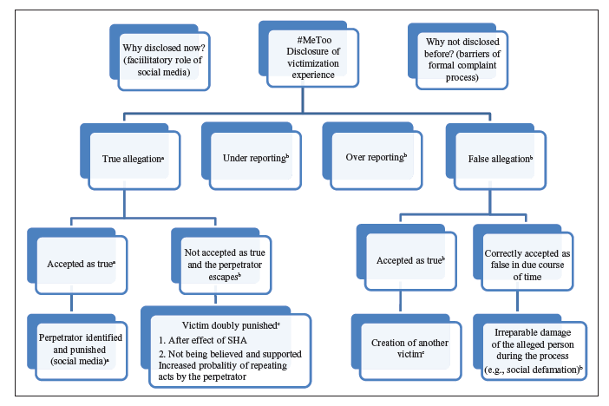
Matrix of Good, Bad, and Ugly Aspects of the “Me Too” Movement

Slide 10
The momentum of the #MeToo movement has broadened the reach of the campaign that activist Tarana Burke started in 2006 to help women of color from under privileged communities who have experienced rape or sexual assault. The campaign received little mainstream media attention until 11 years later, when the phrase was used by prominent White women to share their stories of sexual assault through social media. While the movement has found success with the Weinstein effect, the original audience of the movement—women of color did not share in its success because of the added factor of race.
The role of intersectionality in the #MeToo movement and how the movement has evolved to address intersectionality as part of its overall goal to combat sexual assault and harassment at workplaces.
What is going on beyond the MeToo?

Slide 11
What can be learned from these three movements?
All three movements aim to center the voices of minoritized and marginalized groups—particularly black girls, women and transgender people—by interrogating and disrupting systems of power. One of the ways they do this is by decentralizing power within their movements.
Unlike the civil rights movement of the 1960s, there is no one spokesperson or figurehead. These movements embrace the doctrine that every individual has the ability to lead. As such, decision-making is collaborative, democratic and transparent.

Slide 12
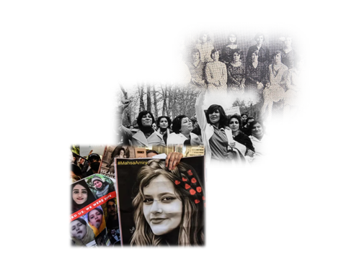
Women's lives in Iran Between the religious-traditional and new horizons
https://www.youtube.com/watch?v=DMsGu-SaYNk

Slide 13
Civil disobedience
In most conservative countries where patriarchal ideas and laws are dominant, women attempt to resist unfair policies, not by deliberate, organized campaigns but through daily practices in public life. Some sociologists like Asef Bayat call these kinds of resistance “social non-movement”. Civil disobedience plays a significant role in shaping social movements.

Slide 14
The Global Feminist and International Organizations Supported the Woman Life Freedom Movement in Iran to make Iranian regime responsible for women’s rights.
The # MahsaAmini was tweeted and retweeted more than 250 million times in Persian and more than 50 million times in English in the first month after her death.
Global Feminism
Transnational Feminism

Slide 15
The MAHSA Act is a bill introduced to the United State Congress in April 2023 and approved with 61 co-sponsors to make the Islamic regime accountable for domestic oppression. That would require the President to determine whether high-ranking officials of the Islamic regime in Iran should be listed under existing US sanctions for human rights abuses and support of terrorism.
The Mahsa Act.

Slide 16
Female foreign ministers from Canada, Albania, Andorra, Australia, France, Germany, Iceland, Kosovo, Libya, Liechtenstein, New Zealand, and Norway put out a strong statement of support for the protesters on Oct. 26 :
“We, as women foreign ministers, are gathered in solidarity with the courageous Iranian women engaging in their right of peaceful assembly and advocating for their human rights. We recognize that Iranian women are also fighting for a better future for all Iranians and we have the moral obligation to support them.”
The ministers called for a “prompt, impartial, and independent investigation into the use of force” by the Iranian authorities and the repression of demonstrations, including severe internet and telecoms restrictions and excessive use of force. Their statement went on, “As women foreign ministers, we feel a responsibility to echo the voices of Iranian women. We condemn the violent enforcement of the chastity law and the ongoing crackdown against protestors in Iran who exercise their right to freedom of opinion and expression.”
Expressing support at the highest levels:

Slide 17
International women’s faith groups released a statement signed by more than 80 organizations, activists, academics, and lawyers, including both Muslims and other faiths, calling on the Iranian government to repeal Article 638 of the penal code (covering dress and punishment), review and change all laws that discriminate against women, and ratify the Convention on the Elimination of All Forms of Discrimination Against Women on Sep. 30, Highlighting existing laws that discriminate against women, the statement cited those “that allow girls to get married before 18, that prescribe male guardianship over women, and discount the testimony of women,” among others. The groups also noted that “Recent polls show that 72% of Iranians do not believe the hijab should be enforced by the government, rather it is a matter of choice for Muslim women.”
Pushing for legal change

Slide 18
On Dec.14, the American non-governmental organization (NGO) Vital Voices International began a campaign calling on U.N. member states to immediately remove the Islamic Republic of Iran from the U.N. Commission on the Status of Women, a global intergovernmental body dedicated to promoting gender equality and women’s empowerment, over its brutal crackdown on the protests. In a statement put out by Vital Voices, the group’s president and CEO, Alyse Nelson, said, “This is an unprecedented woman-led revolution that needs the full support of human rights leaders and organizations, aligned with the member states of the U.N. Commission on the Status of Women and the broader public to in order to be effective.” The U.S. government has backed the effort to remove Iran from the U.N. commission, with Vice President Kam
The Islamic regime of Iran removed from the U.N. Commission on the Status of Women:

Slide 19
The Woman Life Freedom is definitely the first feminist revolution formed and led by Muslim women to meet the deconstructive demands of Women in Iran. I can dare say that such an inclusive, decentralized, and heterogeneous movement in the Middle East, if not to say in the world, is unprecedented.
The Center Party in Egypt
The Justice and Development in Turkey
Islamic Party in Malaysia
Reformist, Eslah-Talab, Party in Iran
Woman Life Freedom struggles for the recognition of all Muslim women

Slide 20
Mourning Mothers
For many years, the main discourse of modern feminism was to fight against gender inequality and women’s oppression through rational strategies that excluded any type of emotional action, in line with the public opinion that politics is the field of reason and rational actions. Such a perspective is rooted in value-based and rational-instrumental social actions exemplified by theorist Max Weber (1936), who described affective actions as irrational and reactive. Therefore, the role of emotions in feminist politics and feminist pedagogy was denied for many years.

Slide 21
“Women Wage Peace” “Women of the Sun”
Palestinian movement “Women of the Sun” and the Israeli movement “Women Wage Peace” are two very current movements run by mothers based on the desire to protect the lives of children on both sides. Thousands of women from the Israeli movement “Women Wage Peace” and the Palestinian movement “Women of the Sun” held a mass event with this message: “We, Palestinian and Israeli mothers, are determined to stop the vicious cycle of bloodshed and to change the reality of the difficult conflict between both nations, for the benefit of our children”.

Slide 22
The Saturday Mothers
The Saturday Mothers in Turkey is another example of mourning mothers against war held by Kurdish mothers, whose sons disappeared due to state actions

Slide 23
Mothers of Khavaran (1988), Mothers of Laleh Park (2009), Mothers of Aban (2019), Mothers of Ukrainian Flight (2020) Mothers of Woman, Life, Freedom movement (2022).
Iranian Mourning Mothers Campaign is one of the most effective digital movements in holding the Islamic regime of Iran accountable for massive violations of human rights, gender inequality, and the killing of a large group of protesters from 1981 to 2022.

